Slide 1
Signaling the Health of Tree-pit Soil
Group 12
Chenye Yang, cy2540
Haokai Zhao, hz2477
Zhuoyue Xing, zx2269
EECS E4764 Fall ‘19 IoT - Intelligent Connected Systems
Columbia university
Prof. Xiaofan (Fred) Jiang
1

Slide 2
What
A long-range, low-power, low-cost soil condition sensing system
Simultaneous measurement of insitu soil moisture, temperature, PH and dissolved oxygen over long duration at multiple locations
Distributed, scalable sensing network: use one microcontroller to link multiple sensing units via wireless communication
Cloud data storage with operation dashboard website
Spatial and temporal data visualization
Why
Urban land is largely covered by impervious surfaces, generating much more runoff during wet-weather flow than a woodland of the same size
The infiltration capacity of the tree-pit soil modulates the street trees’ ability to mitigate stormwater runoff, which in turn is a function of soil system health
Advance understanding of the role of tree pit design and management in urban stormwater management
Broader application potentials including: climate modeling and adaptation, sustainable agriculture, subsurface waste management and groundwater remediation, geotechnical engineering, and so on.
_{Description}
_{What and Why}
2

Slide 3
_{Feature Wish List}
Create a table with a wish list of all the features things you would like to implement in your project. It doesn’t matter if you will be able to implement those items, this is only a wish list. You will later assess the feasibility.
Feature | Description
Soil Condition Sensing Unit | Measure soil moisture, temperature, PH and dissolved oxygen; communicate with the transfer station through LoRa
Distributed, Scalable Sensing Network | Use one microcontroller as a transfer station to link multiple sensing units within an area; the transfer station can properly handle commands and data streams between sensors and cloud
Cloud Data Storage | Store and organize the data collected from the sensors on cloud
Operation Dashboard Website | Human Computer Interface: send command to sensor units; retrieve data from the cloud database; provide spatial and temporal data visualization
Long Duration Deployment | The sensing unit is expected to be deployed in soil for a relative long time between maintenances, e.g., several months.
3

Slide 4
_{Results / Outcome}
Describe the final results and outcome of your project
Level | Description
Bronze | Successfully combine the four sensors with a microcontroller as an integrated sensing unit; the sensing unit can communicate with the transfer station (microcontroller) through LoRa; successfully establish the cloud database, which can store data collected from the sensors
Silver | Beyond bronze: Build an user-friendly operation dashboard website, on which user can conveniently control sensing units and retrieve data from the cloud database
Gold | Beyond Silver: Build spatial and temporal data visualization module on the website; create a compact protection case for the sensing unit in order to protect the unit in soil
4

Slide 5
_{Description}
_{How}
State how does the project work, what are the main technical components
Soil Condition Sensing Unit: Connect four separate sensors (soil moisture, temperature, pH, dissolved oxygen) with a microcontroller as an integrated sensing unit
Transfer Station: Use a single microcontroller as a transfer station, it communicates with the sensing units through LoRa and communicates with the cloud through WiFi
Cloud Server and Database: Build cloud database on Amazon Web Service (AWS) ec2 instance
Operation Dashboard Website: View the location of the sensing units and the transfer station(s); Send command to the transfer station to control sensing units; Retrieve data from the cloud database; Provide spatial and temporal data visualization
5

Slide 6
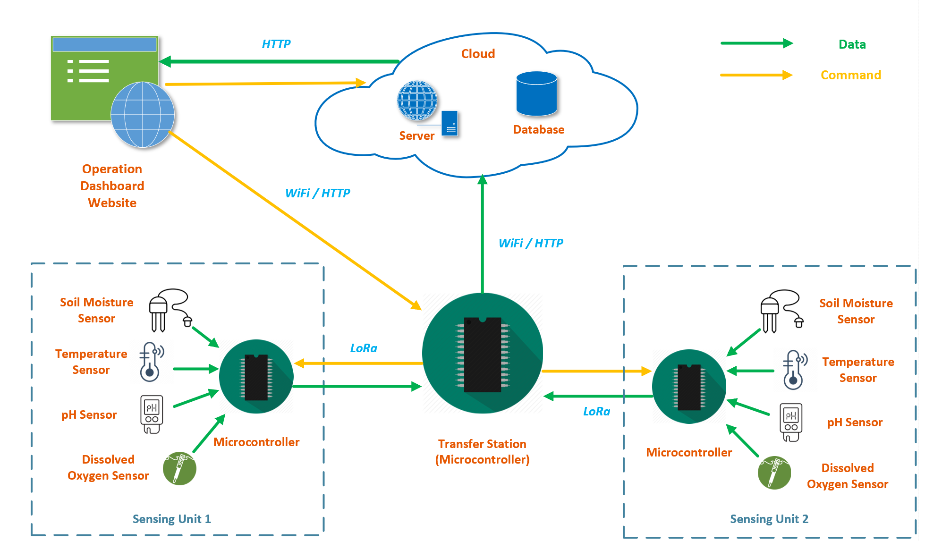
_{Block Diagram}
Draw a block diagram
Include the main blocks/components/modules
Include the high level signals/connectivity
Indicate the flow of data, signals tasks (this may require a second diagram)
6

Slide 7
_{Feasibility Study (Risks)}
Challenges | Feasibility
Connect the four sensors with a microcontroller to build an integrated sensing unit | 3
Configure LoRa communication between the transfer station and the sensing units | 4
Establish a cloud server and database | 2
Build a user friendly, multi-function operation dashboard website, including sensor location display, sensor control panel, data retrieving from the database / data download service, spatial and temporal data visualization | 5
Design a protection case for the sensing unit | 4
7

Slide 8
Components/Resources and Budget
Component | Units | Cost
Adafruit LoRa Radio FeatherWing - RFM95W 433 MHz - RadioFruit | 2 | 39.90
Assembled Feather HUZZAH w/ ESP8266 WiFi With Stacking Headers | 1 | 19.95
Lithium Ion Polymer Battery - 3.7v 500mAh | 1 | 7.95
Edge-Launch SMA Connector for 1.6mm / 0.062" Thick PCBs | 1 | 2.50
SMA to uFL/u.FL/IPX/IPEX RF Adapter Cable | 1 | 3.95
Mini GSM/Cellular Quad-Band Antenna - 2dBi SMA Plug | 2 | 9.90
uFL SMT Antenna Connector | 1 | 0.75
Total |  | 84.90
8

Slide 9
_{Milestones and Timeline}
Create 4 milestones to complete the project. At the end of each milestone, check with TAs for feedback.
Milestone | Description
0 | Integration of the four sensors with the microcontroller
1 | Configuration of LoRa communication between the transfer station and the sensing unit
2 | Establishment of the cloud server and database service
3 | Construction of the operation dashboard website
9

Slide 10
_{References}
List half a dozen or more critical references (papers, presentations, links).
10

